Slide 1

BOOK RECOMMENDER SYSTEM

Slide 2
Team
Rajesh Patil
Chetan Patil
Mrunal Badgujar
Sachin Chaudhari

Slide 3
Content
Problem statement
Data Summary
Analysis of different datasets
Data Cleaning
Outlier treatment
Imputing missing values
Different Recommendation Models
Challenges
Conclusion
Future Scope

Slide 4
Problem Statement
During the last few decades, with the rise of YouTube, Amazon, Netflix, and many other such web services, recommender systems have become much more important in our lives in terms of providing highly personalized and relevant content.
The main objective is to create a recommendation system to recommend relevant books to users based on popularity and user interests.

Slide 5
Data Summary
The dataset is comprised of three CSV files::
User_df, Books_df, Ratings_df Users_dataset.
User ID (unique for each user)
Location (contains city, state, and country separated by commas)
Age Shape of Dataset - (278858, 3)
2. Books_dataset.
ISBN (unique for each book)
Book-Title
Book-Author
Year-Of-Publication
User-ID
Image-URL-S
Image-URL-M
Image-URL-L
Shape of Dataset - (271360, 8)
3. Book-Rating
ISBN
USERID
RATING
The shape of Dataset - (1149780, 3)

Slide 6
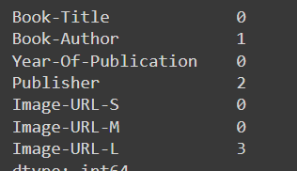
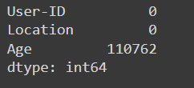
Data Cleaning
We find out null rows and replaced with its real values
E.g. 'Book-Author' replaced with 'Larissa Anne Downes'
'Publisher' replaced with 'Mundania Press LLC' and 'Bantam'
Age have a lot of null values
Checked duplicated values but there are not duplicated values

Slide 7
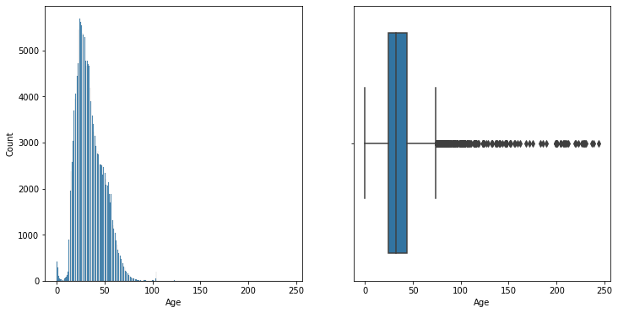
Observations from Users_df (Age)
Age distribution of positively skewed
Most of the users are from the age group 25-50
It is highly unlikely to have users under the age of 4 and above 95. The peaks near 0 and 100 in the kdeplot indicate that there are some outlier values in the 'Age' column
It is highly unlikely to have users of age above 95 and below 4 in this case. Let's replace these values with np. nan
Outliers present in data need to remove

Slide 8
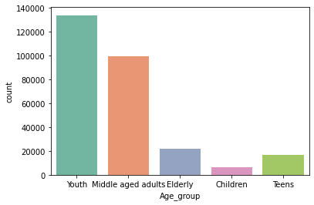
Observations from Users_df (Age)
Most of the users are young followed by a middle-aged menace the range of 20 to 40 age.

Slide 9
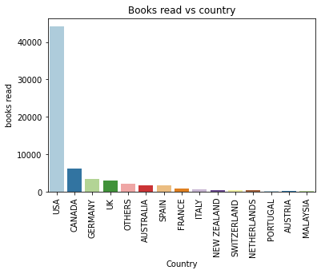
Observations from Users_df (Location)
Splitting the Location column and analyzing the country.
Most active readers are from the USA.

Slide 10
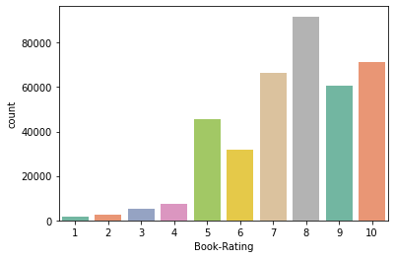
Rating distribution for explicit rating
As we can see from the count rating most of the people gave an 8-star rating followed by 10 stars which is a very good rating
Very few people disliked books

Slide 11
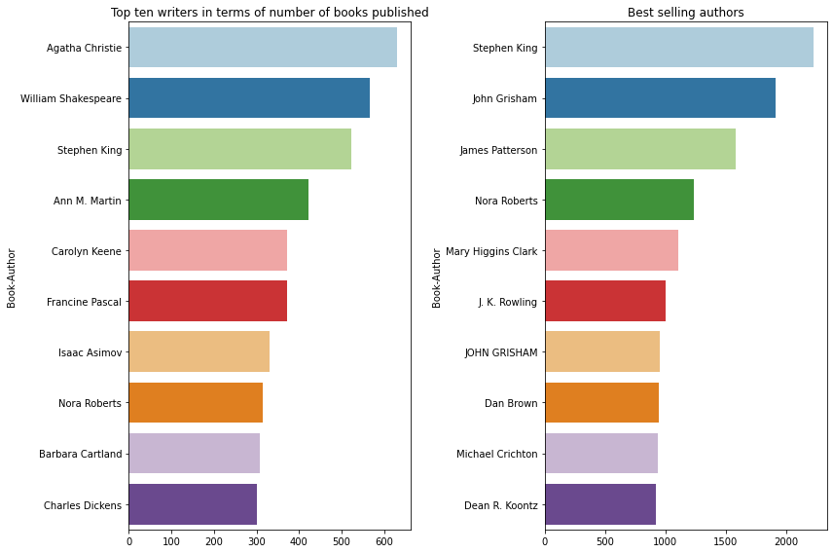
Authored most number of books and Best seller author
Agatha Christie has written and published most number of books
Stephen king is the Bestselling author

Slide 12
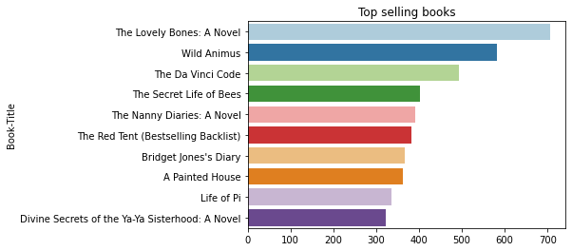
Top selling books
The Lovely Bones: A Novel is the best-seller book in our dataset
most numbers of copies were sold

Slide 13
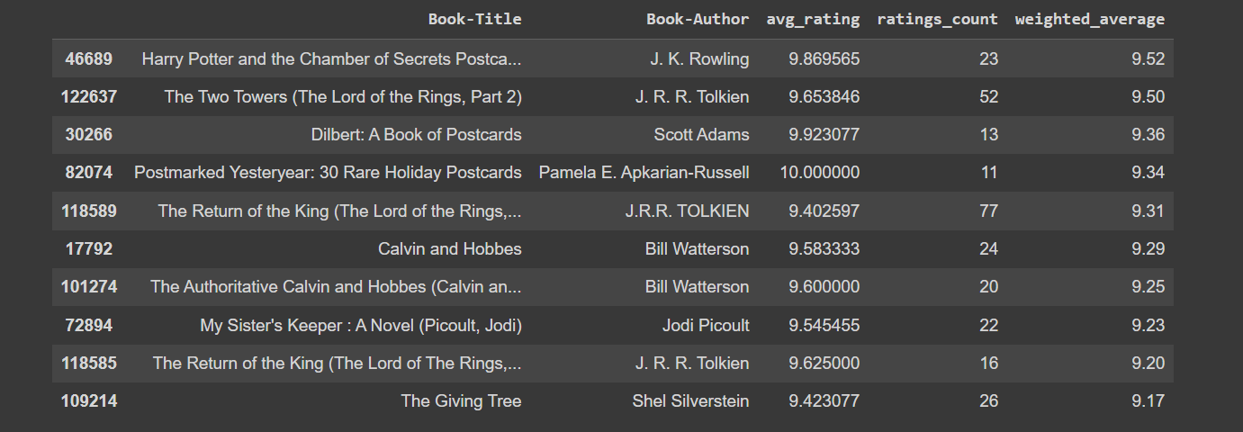
Popularity-based Recommender System
Using Weighted average for each Book’s Average Rating
W = Rv + Cm/(v + m)
where
W= Weighted Rating
R = Average of the Books rating
v = No of people who have rated the books(number of votes)
m = minimum no of votes to be listed
C = the mean rating across all the books

Slide 14
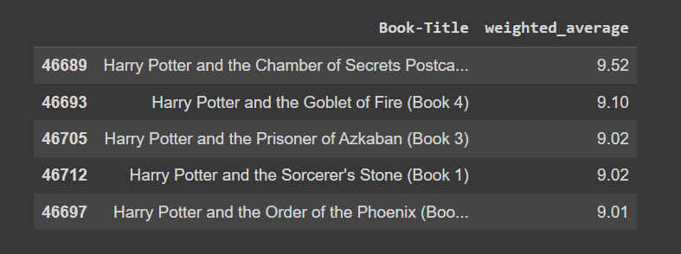
Author-based recommender system
The author of the book Harry Potter and the Chamber of Secrets (Book 2) is J. K. Rowling Here are the top 5 books from the same author

Slide 15
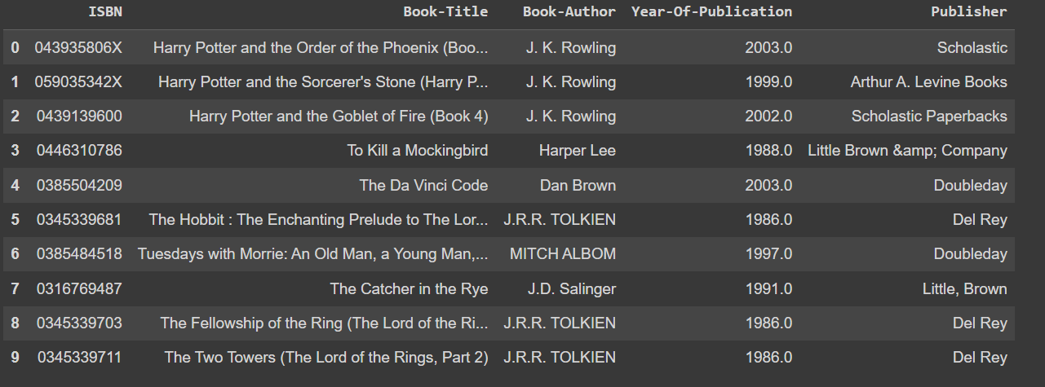
Collaborative filtering
Harry Potter and the Order of the Phoenix has the top recommended book
Followed by Harry Potter and the Sorcerer's Stone

Slide 16
Conclusion
The initial step, of our project was Data preprocessing of the three datasets-books_df,users_df, and ratings wherein we removed duplicates and imputed the missing values & invalid entries with appropriate values and corrected spellings.
Then, we performed Exploratory Data Analysis to find out the countries with maximum users, popular books, popular authors and popular publishing companies. We analyze the rating distribution on, the age distribution of users and the popular books amongst various age groups.
Then, we used the Popularity-based approach, Collaborative filtering approach to build different types of recommendation models.
*We evaluated the performance of Singular Value Decomposition based recommender and obtained a Global Recall@5 of 30 % and Recall@10 of 41%
Among the top 20 Authors the highest number of books has been held by Agatha Christie. Agatha Christie is leading the at with more than 600 counts, followed by William Shakespeare.
Harlequin has most number of books published, followed by Silhouette.
Number of Books published yearly is from 1950 - 2005.
Most of the users between 30-40 prefer more books and somewhat we can also view between 20-30.
As per ratings "Selected Poems" has been rated most followed by "Little Women". The count plot shows users have rated 0 the most, which means they haven't rated books at all.
The top 10 books recommendation as per ratings with top "The Lovely Bones: A Novel" with 707 book ratings. But this is not based on some recommendation system. They are top 10 books as per ratings.
As we perform by cosine similarity in recommendation system it gives 7.94 RMSE scores and SVD improved score it to 1.63 RSME score by Singular Value Decomposition model (SVD).
The evaluation metrics for SVD is the best RMSE score for all datasets (i.e. user data, ratings data,a and books data).
Adel-basedsed approach was best to signify and at last we got top 10 recommended books and ratings respectively.

Slide 17


THANK YOU

